Slide 1
Corpus annotation
Studienamiddag werkgroep Digital Humanities
Katrien Depuydt, Jesse de Does
katrien.depuydt@ivdnt.org
jesse.dedoes@ivdnt.org

Slide 2
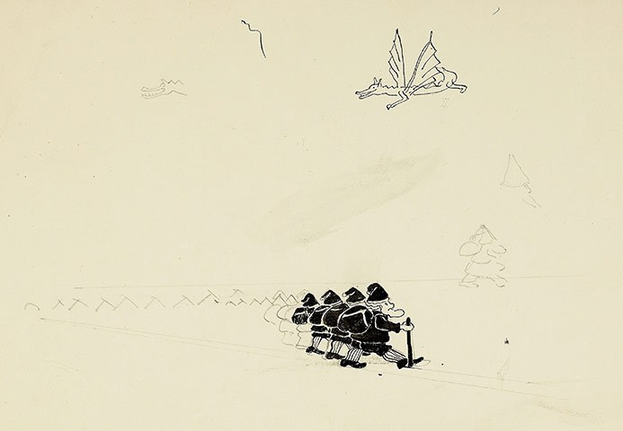
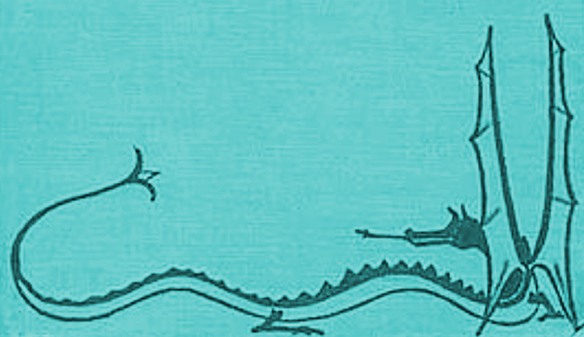

Program
14:00 - 14:30 An Unexpected Party. Introductie van het nieuwe INT. Frieda Steurs
14:30 - 15:00 Riddles in the Dark. Over corpusbouw. Katrien Depuydt
15:00 - 15:30 Out of the Frying-Pan into the Fire. Over corpusannotatie. Jesse de Does
15:30 - 15:45 Theepauze
15:45 - 16:15 Inside Information. Over corpus search. Jan Niestadt
16:15 - 16:45 The Gathering of the Clouds. Lexical resources en Linked Open Data. Jesse de Does/Katrien Depuydt
16:45 - 17:00 Ruusbroec at your fingertips. Guy de Pauw
Notes:
WP2 will offer a generic linked open data graph populated with for the humanities relevant entities like Persons, Locations, Concepts etc. The graph serves for network analysis, data annotation resolution and linking purposes. The graph is populated with datasets from the exposed domain graphs and sources outside the three core groups like old thesauri, biographical collections and external datasets like dbpedia.
https://i2.wp.com/www.brainpickings.org/wp-content/uploads/2011/10/artofthehobbit3.jpg?zoom=1.75&w=680&ssl=1
https://www.brainpickings.org/2011/11/01/art-of-the-hobbit/

Slide 3
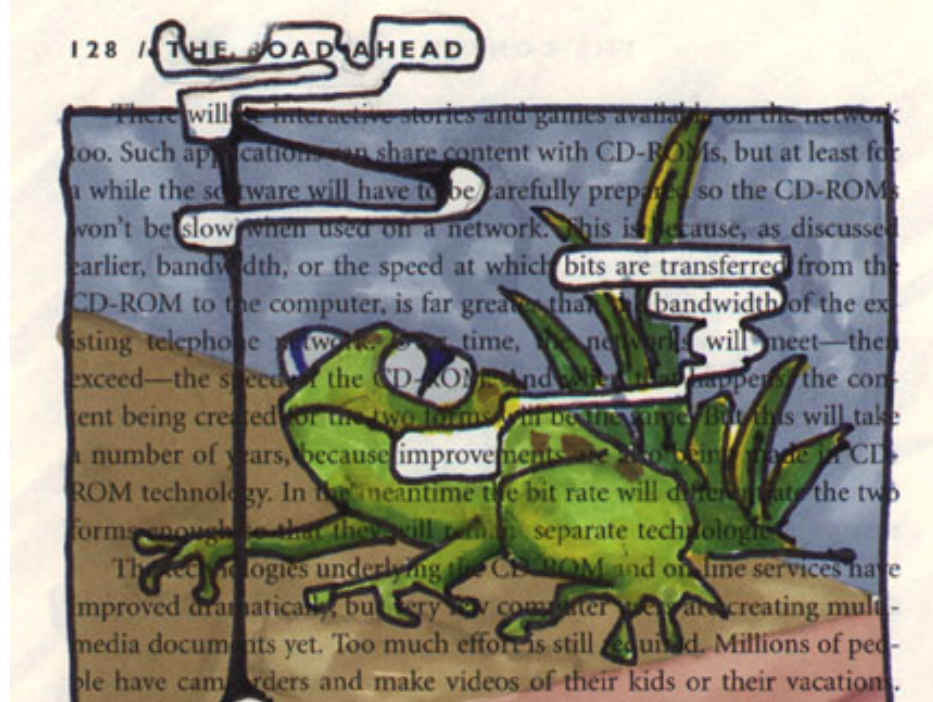
Out of the Frying-Pan into the Fire corpus annotation

Slide 4
Corpus annotation layers
Basic layers:
lemma
part of speech
named entities
recognition
linking
Syntax: treebanks
Semantics/pragmatics:
word sense annotation
coreference
Notes:
WP2 will offer a generic linked open data graph populated with for the humanities relevant entities like Persons, Locations, Concepts etc. The graph serves for network analysis, data annotation resolution and linking purposes. The graph is populated with datasets from the exposed domain graphs and sources outside the three core groups like old thesauri, biographical collections and external datasets like dbpedia.

Slide 5
Annotation tools
PoS taggers (+ lemmatizers), NER, parsing, semantic tagging, …
Frog https://languagemachines.github.io/frog/ (online version in TTNWW)
OpenConvert http://openconvert.clarin.inl.nl (modern Dutch)
“INL labs” http://inl-labs.inl.nl (historical dutch)
Run on own hardware / Web-service based

Slide 6
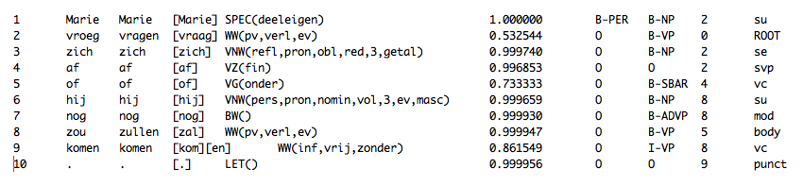
Input and output
Input: usually plain text or some XML
TEI http://www.tei-c.org
FoLiA https://proycon.github.io/folia/
Output: (verbose) XML or plain text

Slide 7
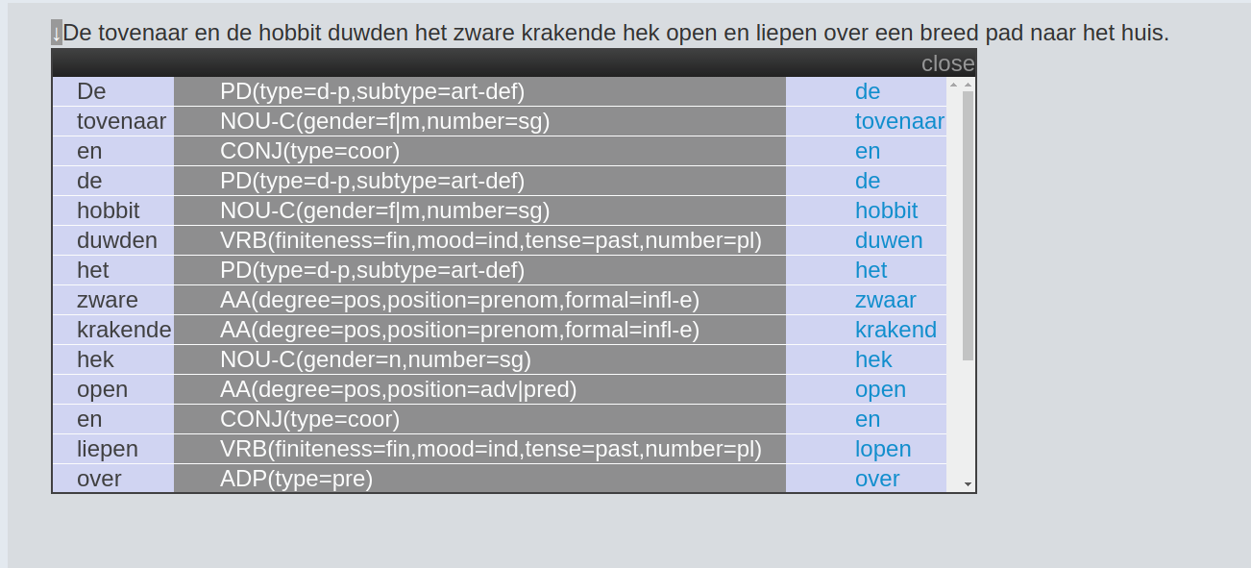
example PoS tagging: modern
<s>
<w lemma="de" type="PD(type=d-p,subtype=art-def)" xml:id="w.0">De</w>
<w lemma="tovenaar" type="NOU-C(gender=f|m,number=sg)" xml:id="w.1">tovenaar</w>
<w lemma="en" type="CONJ(type=coor)" xml:id="w.2">en</w>
<w lemma="de" type="PD(type=d-p,subtype=art-def)" xml:id="w.3">de</w>
<w lemma="hobbit" type="NOU-C(gender=f|m,number=sg)" xml:id="w.4">hobbit</w>
<w lemma="duwen" type="VRB(finiteness=fin,mood=ind,tense=past,number=pl)" xml:id="w.5">duwden</w>
<w lemma="het" type="PD(type=d-p,subtype=art-def)" xml:id="w.6">het</w>
<w lemma="zwaar" type="AA(degree=pos,position=prenom,formal=infl-e)" xml:id="w.7">zware</w>
<w lemma="krakend" type="AA(degree=pos,position=prenom,formal=infl-e)" xml:id="w.8">krakende</w>
<w lemma="hek" type="NOU-C(gender=n,number=sg)" xml:id="w.9">hek</w>
<w lemma="open" type="AA(degree=pos,position=adv|pred)" xml:id="w.10">open</w>
<w lemma="en" type="CONJ(type=coor)" xml:id="w.11">en</w>
<w lemma="lopen" type="VRB(finiteness=fin,mood=ind,tense=past,number=pl)" xml:id="w.12">liepen</w>
<w lemma="over" type="ADP(type=pre)" xml:id="w.13">over</w>
<w lemma="een" type="PD(type=indef,subtype=art-indef)" xml:id="w.14">een</w>
<w lemma="breed" type="AA(degree=pos,position=prenom)" xml:id="w.15">breed</w>
<w lemma="pad" type="NOU-C(gender=n,number=sg)" xml:id="w.16">pad</w>
<w lemma="naar" type="ADP(type=pre)" xml:id="w.17">naar</w>
<w lemma="het" type="PD(type=d-p,subtype=art-def)" xml:id="w.18">het</w>
<w lemma="huis" type="NOU-C(gender=n,number=sg)" xml:id="w.19">huis
<lb />
</w>
<pc type="post" xml:id="pc.000001">.</pc>
</s>

Slide 8
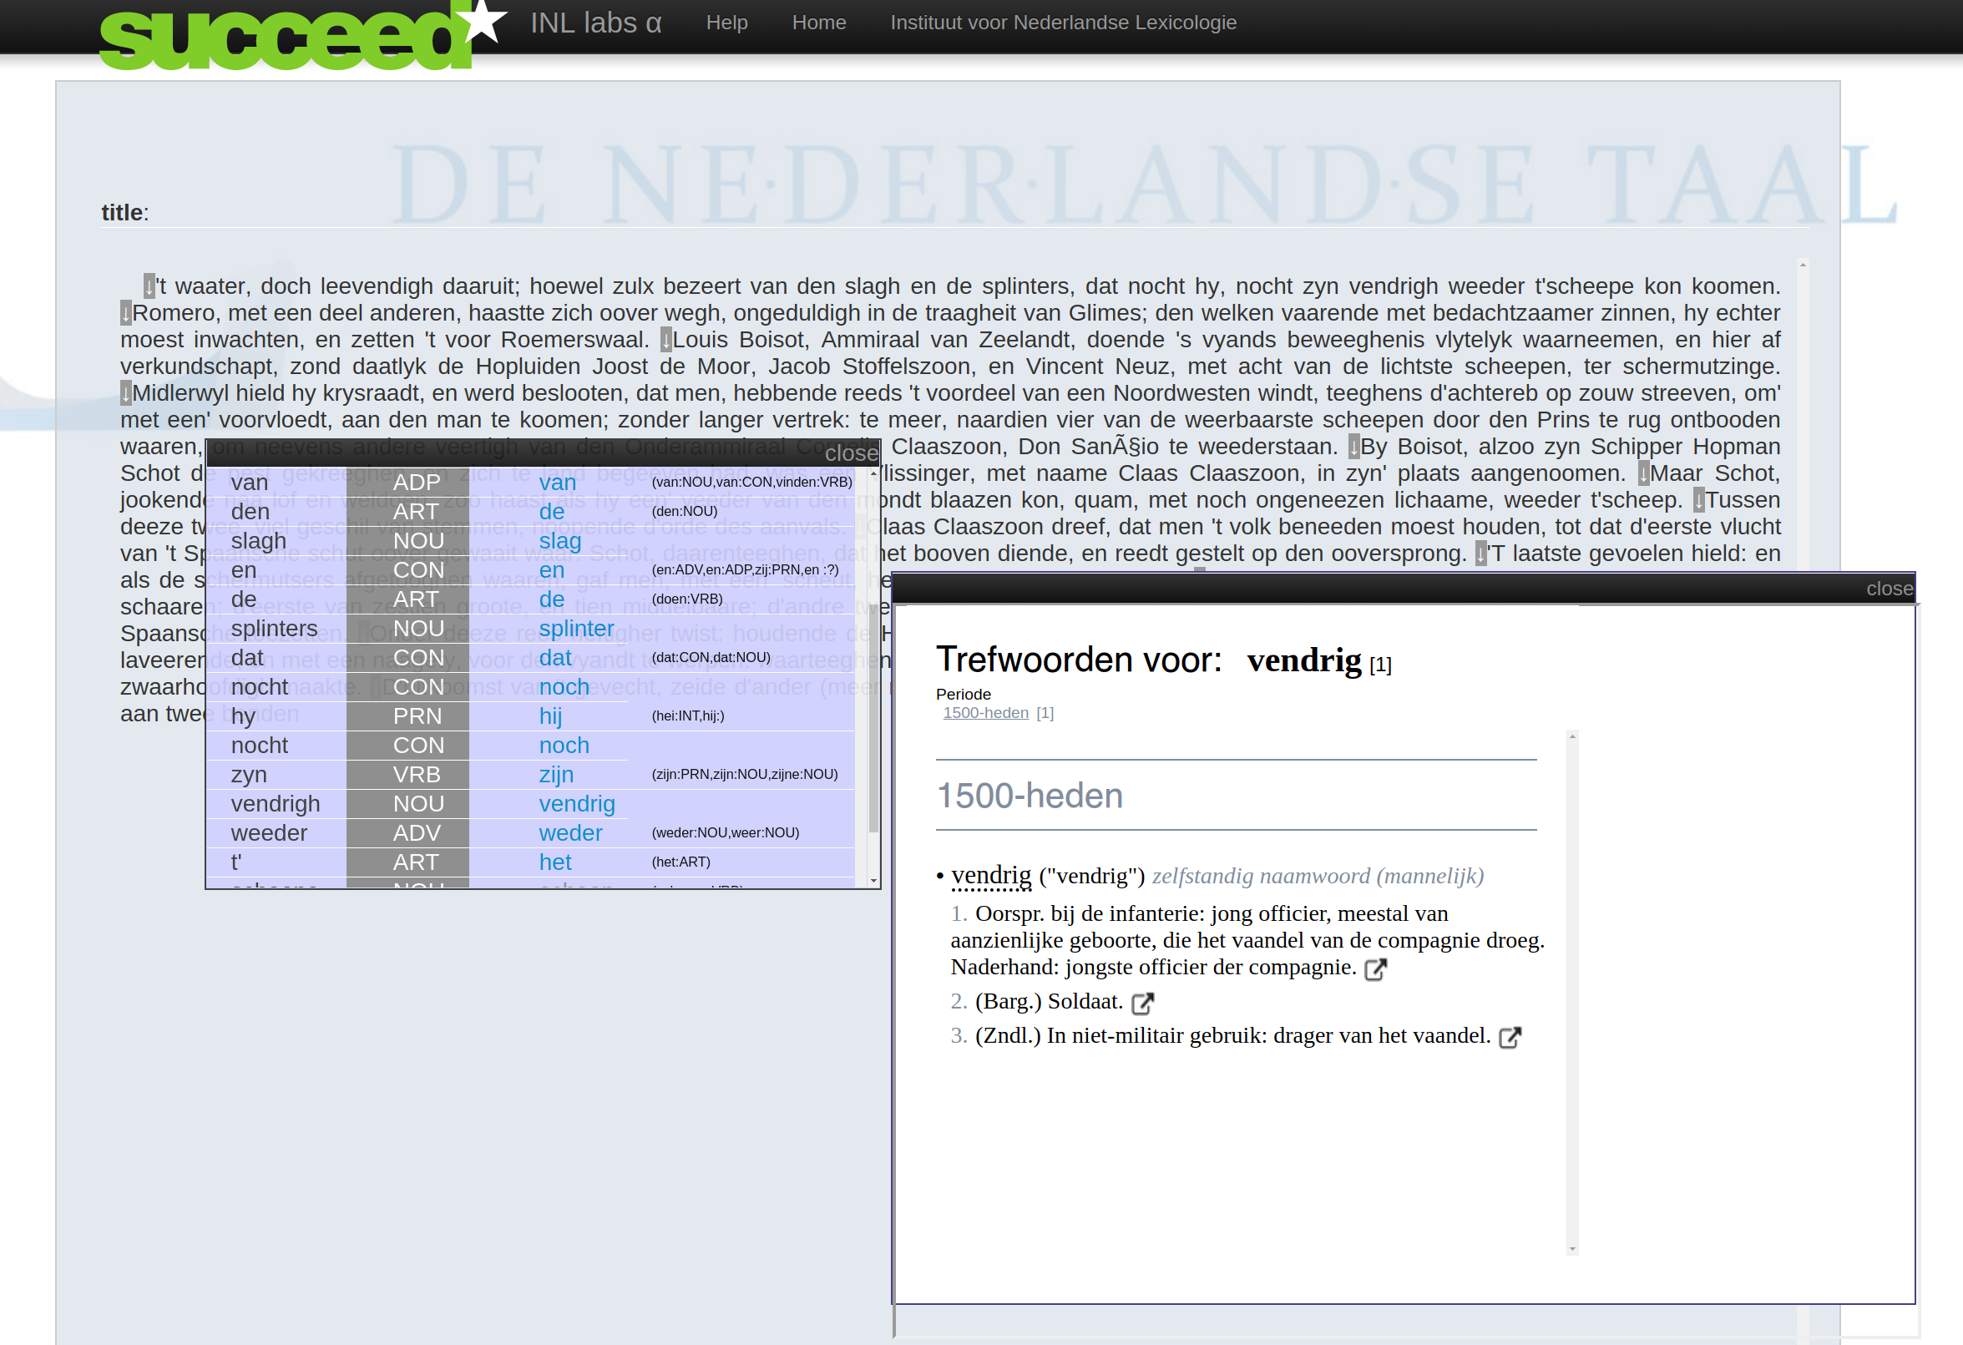
Part of speech tagging: historical
Notes:
INL labs:
Trainable statistical tagger (SVM), online instance trained on letters as loot data (~400.000 tokens 17th and 18th century Dutch)
Uses historical lexicon and approximate matching for lemmatization

Slide 9
Example text
Zynde zynde N(soort,ev,basis,zijd,stan)
nu nu BW()
juist juist BW()
in in VZ(init)
het het LID(bep,stan,evon)
goed goed ADJ(vrij,basis,zonder)
voor voor VZ(init)
hetgeen hetgeen VNW(betr,det,stan,nom,zonder,zonder-n)
mynen mynen N(soort,mv,basis)
stiel stiel N(soort,ev,basis,zijd,stan)
betreft betreffen WW(pv,tgw,met-t)
ik ik VNW(pers,pron,nomin,vol,1,ev)
durf durven WW(pv,tgw,ev)
my my SPEC(vreemd)
op op VZ(init)
uwe uw VNW(bez,det,dial)
gewoone gewoone N(soort,ev,basis,zijd,stan)
welwillend welwillend ADJ(vrij,basis,zonder)
heid heid WW(od,vrij,zonder)
betrouwen betrouwen WW(inf,vrij,zonder)
om om VZ(init)
eene eene ADJ(prenom,basis,met-e,stan)
goede goed ADJ(prenom,basis,met-e,stan)
antwoord antwoord N(soort,ev,basis,onz,stan)
op op VZ(init)
mynen mynen N(soort,mv,basis)
brief brief N(soort,ev,basis,zijd,stan)
te te VZ(init)
bekomen bekomen WW(inf,vrij,zonder)
In in VZ(init)
afwachting afwachting N(soort,ev,basis,zijd,stan)
blyve blyve WW(pv,verl,ev)
ik ik VNW(pers,pron,nomin,vol,1,ev)
met met VZ(init)
den de LID(bep,dial)
grootsten grootsten ADJ(dial)
eerbied eerbied N(soort,ev,basis,zijd,stan)
Zynde VRB zijn
nu ADV nu
juist ADV juist
in ADP in
het ART het
goed NOU goed
voor ADP voor
hetgeen PRN hetgeen
mynen PRN mijn
stiel NOU stiel
betreft VRB betreffen
ik PRN ik
durf VRB durven
my PRN ik
op ADP op
uwe PRN uw
gewoone ADJ gewoon
welwillend NOU welwillend
heid NOU heide
betrouwen VRB betrouwen
om CON om
eene ART een
goede ADJ goed
antwoord NOU antwoord
op ADP op
mynen PRN mijn
brief NOU brief
te ADP te
bekomen VRB bekomen
In ADP in
afwachting NOU afwachting
blyve VRB blijven
ik PRN ik
met ADP met
den ART de
grootsten ADJ groot
eerbied NOU eerbied
en den heer Direkteur
van het Bederlaers Werkhuis
Brugge.
Bruggen den 27 Maert 1864
Mynheer
Den ondergeteekende op gesloten in het
bedelaers-werkhuis van Brugge sedert den
28 Oogst 1862 heeft de eer
UEu edele te verzoeken
my te willen voorstellen aen den heer
Burgmeester van Bruggen voor het bekomen
myner vryheid. Zynde nu juist in het goed
voor hetgeen mynen stiel betreft
ik durf my op uwe gewoone
welwillend heid betrouwen om eene goede
antwoord op mynen brief te bekomen
In afwachting blyve ik met den
grootsten eerbied
Uwen onderdanigen Dienaer
Franciscus Hendrickx

Slide 10
Tagger invocation example
import scala.xml._
object Tagger
{
def bab_tagger_url(text:String):String = s"http://inl-labs.inl.nl/succeed/text?input=${java.net.URLEncoder.encode(text)}&format=text&tagger=bab-tagger&output=raw"
def chn_tagger_url(text:String):String = s"http://openconvert.clarin.inl.nl/openconvert/text?input=${java.net.URLEncoder.encode(text)}&format=text&tagger=chn-tagger&output=raw&to=tei"
def getTextButNotIn(x:Node,tagName:String):String =
if (x.isInstanceOf[Text])
x.text
else
x.child.filter(_.label != tagName).map(getTextButNotIn(_,tagName)).mkString("")
def tag(f:String=>String, text:String) =
{
val d = XML.load(f(text))
val z = (d \\ "w").map(w =>
List(
("word", getTextButNotIn(w,"interp")),
("lemma", (w \ "@lemma").text),
("pos", (w \ "@type").text)))
z.foreach(println)
}
}
Tagger.tag(Tagger.bab_tagger_url,"De Aerde nu was woest ende ledich, ende duysternisse was op den afgront: ende de Geest Godts sweefde op de Wateren.")

Slide 11
Named entity recognition: “modern”
Die dag zongen ze niet en vertelden ook geen verhalen, hoewel het weer beter werd; en ook de volgende dag en de dag daarna niet. Ze voelden nu dat het gevaar aan weerskanten niet ver weg was. Zij overnachtten onder de sterren en hun paarden kregen meer te eten dan zij, want er was volop gras, maar er zat niet veel in hun zakken, ook niet met dat wat zij van de trollen hadden genomen. Op een morgen doorwaadden zij de rivier op een brede, ondiepe plek vervuld van het lawaai van ratelende stenen en brui ­ send schuim. De andere oever was steil en glibberig. Toen zij de top ervan hadden bereikt, hun pony's leidend, zagen zij dat zij de grote bergen heel dicht genaderd waren. Zij schenen nu nog slechts een dag gaans van de voet van de dichtstbijzijnde verwijderd te zijn. Hij zag er donker en naargeestig uit, hoewel er vlekken zonlicht op de bruine hellingen lagen, en achter zijn rondingen glinsterden de toppen van sneeuwkappen. 'Is dat De Berg?' vroeg Bilbo op plechtige toon, terwijl hij er met ronde ogen naar keek. Hij had nog nooit eerder zo iets groots gezien.
'Natuurlijk niet!' zei Balin. Mat is slechts het begin van de Nevelbergen en wij moeten er op de een of andere manier door, of erover, of eronder voor ­ dat wij Wilderland erachter kunnen bereiken. En het is ook van de andere kant nog een behoorlijk eind naar de Eenzame Berg in het oosten waar Smaug op onze schat ligt.
'0!' zei Bilbo en op dat ogenblik voelde hij zich vermoeider dan hij zich ooit had gevoeld. Hij moest weer denken aan zijn luie stoel voor de haard in de geliefde zitkamer van zijn hobbit-hol en aan de ketel die zong. En niet voor de laatste keer!
Nu ging Gandalf voorop. 'Wij mogen de weg niet mislopen, anders zijn we er geweest,' zei hij. 'Wij hebben in de eerste plaats eten nodig, en rust in re ­ delijke veiligheid - ook is het absoluut noodzakelijk om de Nevelbergen langs het goede pad in te trekken, anders raak je erin verdwaald en moet je teruggaan en weer helemaal opnieuw beginnen (als je tenminste nog te ­ rugkomt).' Ze vroegen hem waar hij heenging en hij antwoordde: 'Jullie zijn nu vlak bij de rand van de Wildernis gekomen, zoals sommigen van jullie wellicht weten. Ergens voor ons, verscholen, ligt het schone dal Ri ­ vendell, waar Elrond woont in het Laatste Huiselijke Huis. k heb mijn vrienden een boodschap meegegeven en wij worden verwacht.'

Slide 12
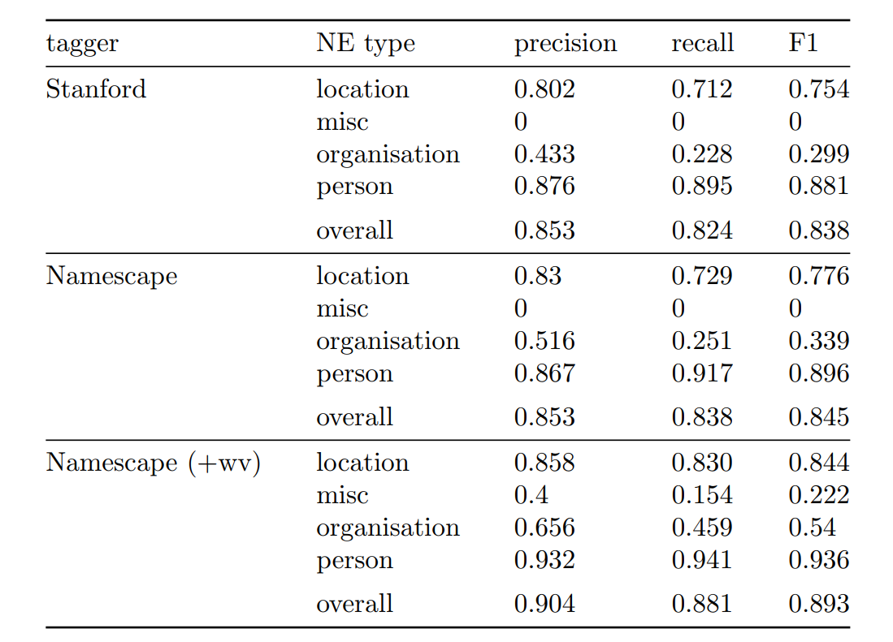
Namescape: NER for literary studies

Slide 13
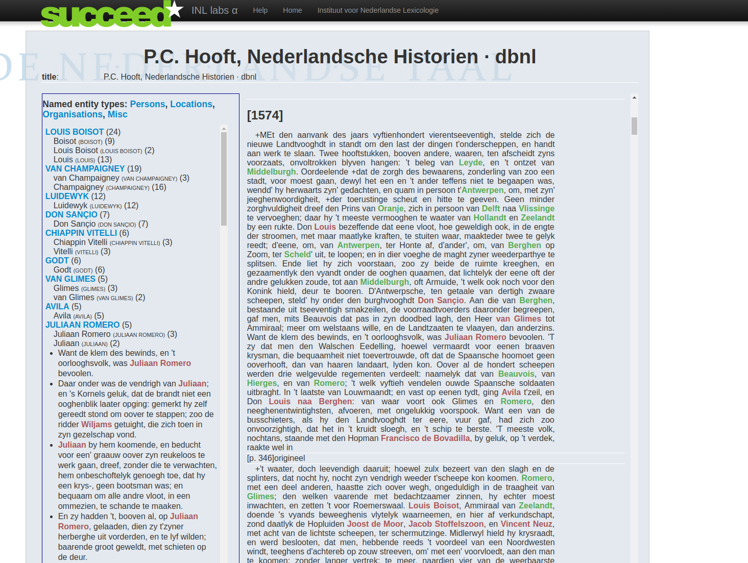
Named entity recognition: historical

Slide 14
INT sequence taggers
Taggers
PoS (modern/historical)
NER
Technical details
SVM^{light} (c++) for training
Tagging in java
Historical lexicon used for lemmatization, in combination with approximate match
TEI input and output possible
Uses word embeddings and (for NER) other semi-supervised features
Currently published only as web services
training procedure invokes executable for SVM-light, rather involved

Slide 15
But….
This is all very nice but:
Tools perform badly for non-standard-modern language
Developing training material for other material is a huge effort

Slide 16
Required effort: training/eval data
To do: harmonize,share, make benchmark sets
Corpus Gysseling | 1.6M
CRM | 650k
Adelheid training sets | ?
Gentse Brieven | 70k
Brieven als Buit | 400k
Hooft letters | ?
Statenvertaling | ?
“Corpus Vosters” | ~100k
IMPACT evaluation corpora | ~20k
Nederlab evaluation data (tbd) | At least 10k per century
Notes:
Similar for NER:
CONNL
Sonar
Namescape
Historical sets IMPACT

Slide 17
Tagset issues
CGN/DCOI dominant for modern Dutch, but some issues with historical Dutch:
Principle tag + lemma ⇒ (almost) determines word form cannot be maintained historically
(likewise for CG/CRM): tagging inflection instead of case/number/mood/tense etc does not benefit (diachronic) analysis
Details:
Mood cannot be lumped with tense historically (PVTIJD = tegenwoordig, verleden, imperatief, conjunctief.)
“dial” for all non-standard-modern words is unsatisfactory

Slide 18
Diachronic and synchronic tagsets
CGN/DCOI http://www.hum.uu.nl/medewerkers/p.monachesi/papers/vaneynde.pdf
Corpus Gysseling/Corpus van Reenen-Mulder
Adelheid tagset http://adelheid.ruhosting.nl/download/Adelheid1_TagsetManual.pdf
Main PoS only in Brieven als Buit en Gentse Spelen
GiGaNT tagset http://www.ivdnt.org/images/stories/onderzoek_en_onderwijs/publicaties/TaalbankWorkingpaper3.pdf
International standards (Gold, eagles, parole, …)
Universal dependencies, adopted in CLARIN/CLARIAH http://universaldependencies.org/

Slide 19
Smarter software?
Can we avoid a huge effort of training corpus building??
More advanced supervised learning (deep….)
Domain adaptation techniques
Semi-supervised techniques
Map to “modernized” Dutch
Derive lexica from parallel text
Transfer tagging by alignment

Slide 20
Tools for manual annotation
https://github.com/INL/COBALT
CoBaLT is an application in which a corpus of texts can be loaded so as to be able to annotate its tokens (lemmatize and more). The annotation work in CoBaLT gives two products: an annotated corpus, and a lexicon consisting of word forms and their corresponding lemmata and such assigned to them.
https://github.com/INL/AttestationTool
The Attestation Tool is a multi purpose GUI used in the production of computational lexica and gold standard data for NE tagging. It addresses the situation of having a comprehensive dictionary consisting of headwords (lemmata) and corresponding quotations in which occurrences of the headwords were automatically matched.

Slide 21
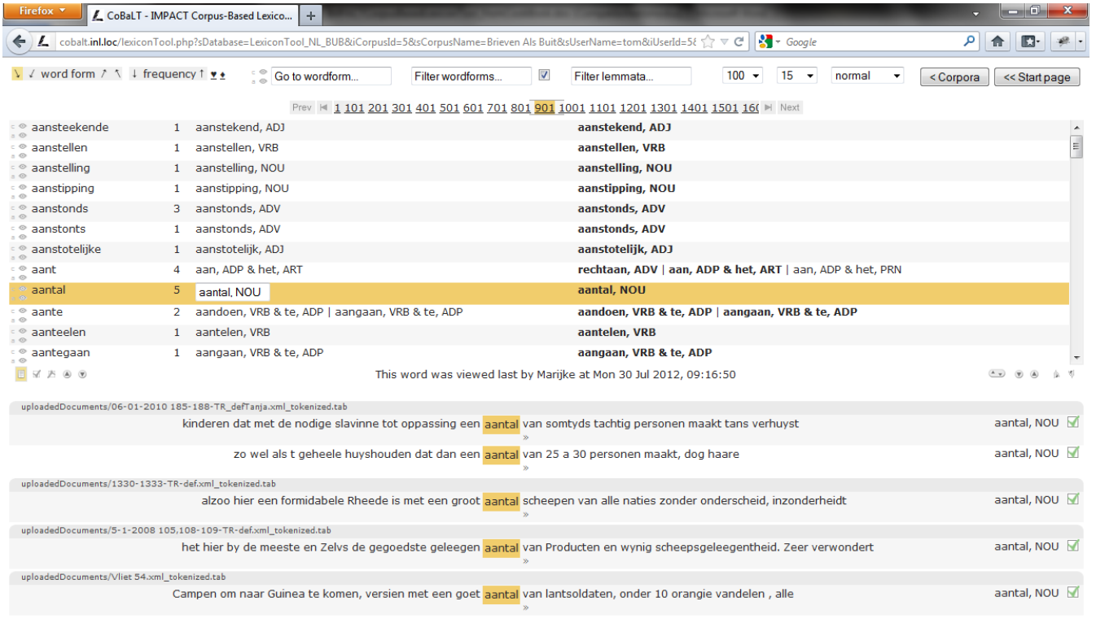

Slide 22
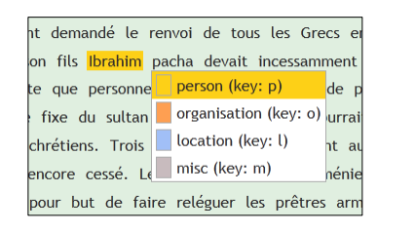
Named entity annotation tool=dictionary attestation tool

